Slide 1

Linux Device Drivers
Lection 2
Roman Okhrimenko 2019

Slide 2
Questions to answer on this lection
1. What is Linux Device Tree?
2. Another language?
3. Device Tree files syntax overview
4. I2C and USB bus based drivers implementation overview - similar?
5. Autodetecting and issues with it, Udev rules
6. Industrial I/O subsystem overview
7. IIO subsystem interface example

Slide 3
What is Linux Device Tree
It is new approach to describing hardware that is actually present in system.
A way to isolate hardware description from kernel image.
OS independent thus widely portable between different systems.
Describes device information in a system that cannot be dynamically detected by a client program.
Effective with corresponding drivers that support Device Tree bindings

Slide 4
Another language
Device Tree uses special language to implement concept.
Files extensions are .dts (source) and .dtsi (includes) – C style
Device Tree files need to be compiled to a binaries with Device Tree Compiler.
Binary files extensions .dtbo
Folder to search for Device Tree files /arch/arm/boot/dts
/arch/arm/boot/dts/overlays

Slide 5
Device Tree files Syntax overview
Thomas Petazzoni – Device Tree for Dummies

Slide 6
Device Tree files examples

Slide 7
I2C, SPI and USB bus based drivers
I2C, SPI bmp085 pressure sensor example
*core.c file to implement bmp085 sensor functionality
*-i2c.c file to implement binding to I2C bus in system
*-spi.c file to implement binding to SPI bus in system

Slide 8
I2C, SPI and USB bus based drivers

Slide 9
I2C, SPI and USB bus based drivers
bmp280_spi_probe() {… return bmp280_common_probe(&spi->dev, …));}
bmp280_spi_remove() {…}
bmp280_spi_read() {…}
bmp280_spi_write() {…}
bmp280-spi.c
bmp280_i2c_probe() {… return bmp280_common_probe(&client->dev, …));}
bmp280_i2c_remove() {…}
bmp280_i2c_read() {…}
bmp280_i2c_write() {…}
bmp280-i2c.c
bmp280_common_probe() {… implementation for device …}
bmp280_common_remove() {…}
struct iio_dev population <- bme280_chip_info
iio channels description
methods registered to chip info implementation
bmp280-core.c

Slide 10
I2C, SPI and USB bus based drivers
STM32Leds USB bus char device driver
- register device to USB bus subsystem
implement usb_class_driver device interface requirements
use USB API calls in read/write/open/release

Slide 11
Autodetecting and issues with it
Refer to
https://github.com/romanjoe/os-course-labs/tree/master/usb

Slide 12
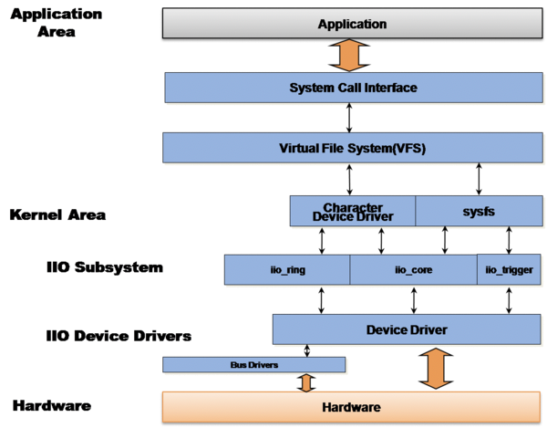
Industrial I/O subsystem overview
a subsystem to support functional requirements of typical hardware classes like ADC, DAC, MEMS sensors
sensors mostly based on I2C and SPI buses data supply
used with devices with higher updates rate up to 100M samples/sec
https://wiki.analog.com/software/linux/docs/iio/iio

Slide 13
Industrial I/O subsystem overview
Industrial IO subsystem
stack overview
https://wiki.st.com/stm32mpu/wiki/IIO_overview

Slide 14
IIO Subsystem
Continuing with bmp280 driver code

Slide 15
Industrial I/O Subsystem
Continuing with bmp280 driver code
same as for k-attributes in sysfs
with special macro helper
dedicated IIO info structure
dedicated IIO device structure

Slide 16
References
https://bootlin.com/pub/conferences/2013/elce/petazzoni-device-tree-dummies/petazzoni-device-tree-dummies.pdf
https://www.raspberrypi.org/documentation/configuration/device-tree.md
https://static.lwn.net/images/pdf/LDD3/ch13.pdf
https://elinux.org/images/5/53/10-Years-of-the-Industrial-IO-Kernel-Subsystem-Jonathan-Cameron-Huawei.pdf
http://reactivated.net/writing_udev_rules.html
https://wiki.st.com/stm32mpu/wiki/IIO_overview
https://wiki.analog.com/software/linux/docs/iio/iio
https://youtu.be/NDXYpR_m1CU - Linux kernel debugging tools and approaches

